Slide 1
Unit test

Slide 2
It’s a situational thing – the team decides what makes sense to be a unit for purposes of their understanding of the system and its testing
Martin fowler
https://martinfowler.com/bliki/UnitTest.html

Slide 3
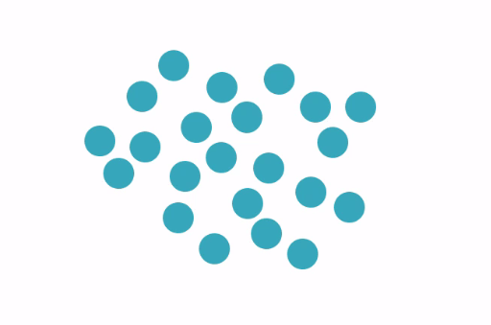

Slide 4
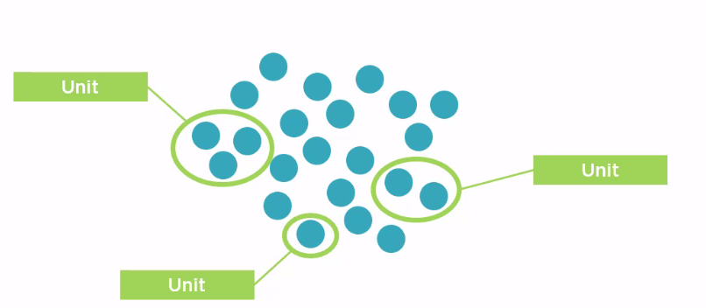

Slide 5
Mocking
Replacing actual dependency

Slide 6
Why Mock?
Reduced test complexity
Improved test execution speed
Support parallel development streams
Real dependency not yet available
Another team
Improve test predictability
Reduce testing costs

Slide 7
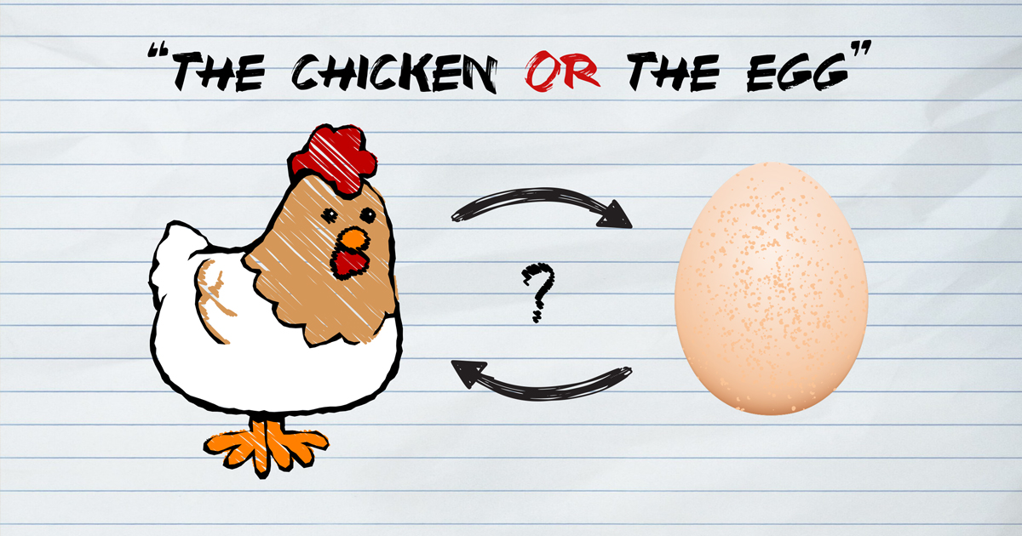
Chicken-egg problem in software development

Slide 8
Test first or code first?
It’s clean code that matters
TDD provides opportunity to create a masterpiece that proactively unbreakable and reduce time to market.

Slide 9
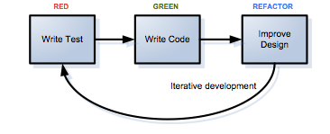
TDD is easier than I thought

